Slide 1

Advanced Programming - 89-211 BIU
Flight simulator remote control – android app
By Noam Salomon & Lola Sirota

Slide 2
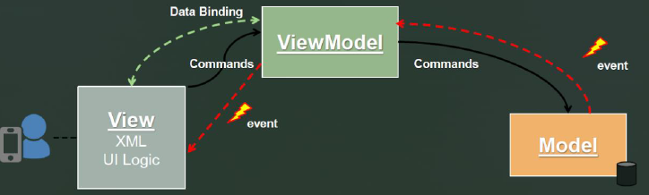
design pattern - MVVM

Slide 3
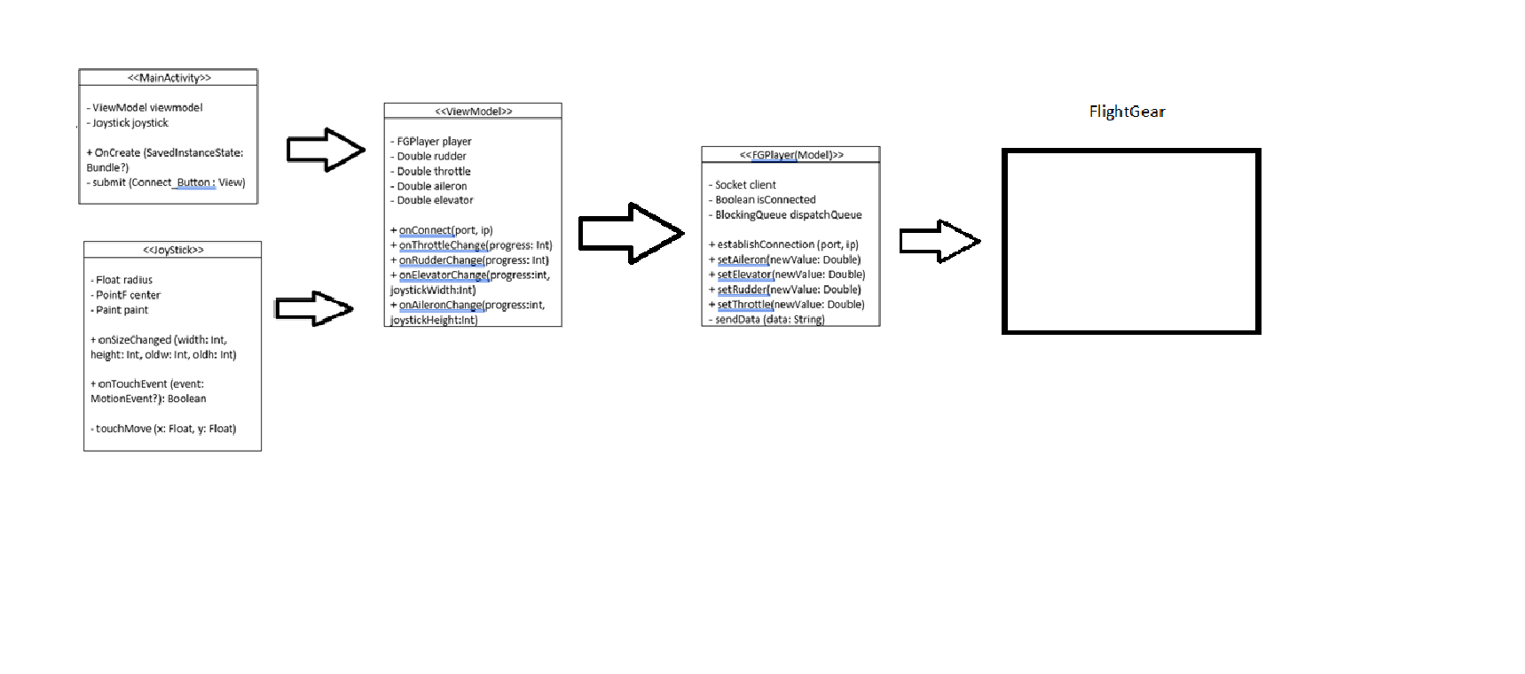

Project architecture

Slide 4
MODEL
The model implements the active object design pattern
This class establishes connection to the flight gear APP and sends over the data from the controls

Slide 5
View-MOdel
This class is responsible for all the UI-Model linking.
It’s been used by MainActivity in order to update the Model regarding to changes in the UI

Slide 6
view
The MainActivity and Joystick classes are all about the UI experience
MainActivity’s roll is to show the main screen and the Joystick, as well as to update the viewModel about UI changes
Joystick’s roll is to be in-charge of the joystick object. It holds an un-implemented function that’s been called during it’s operations. It is who ever holds a reference to joystick (MainActivity) who needs to implement this function - Strategy Pattern

Slide 7
demo

